Slide 1
The Transformation of the Concept of Terrorism - A Text Analysis from New York Times 1850-1980
Annual Meeting of American Society of Criminology
Yu-Hsuan Liu & Tzu-Ying Lo,
11/17/2021, Chicago

Slide 2
Literature Review
The Definition of Terrorism (Hoffman, 2006)
Vague idea or impression for most people
Modern media:
Complex and convoluted messages
Labelling of a range of violent acts as terrorism

Slide 3
Literature Review
The Transformation of the Definition of “Terrorism” (Hoffman, 2006)
The end of the 18th century:
positive connotation, virtue, revolutionary, and democracy.
In the 1930s:
Revolutionary movement and violence against the government and their leaders.
Following WWII:
Revolutionary, national liberation and self-determination.
In the 1960s and 1970s:
Nationalism and separatism outside of colonial oppression.

Slide 4
What Do We Know?
Public’s perception of “terrorism” was affected by media (Nellies and Savage, 2012; Mitnik et al. , 2018)
The conception of terrorism kept changing (Hoffman, 2006)
The definition of “terrorism” is conceptualized by counting the frequencies of its elements (Schmid et al., 1988) from scholars’ definitions.

Slide 5
What Gap Can We Bridge?
Few studies of media and terrorism use news texts before 1970. (Mitnik et al. , 2018; Jetter, 2019; Chermak and Gruenewald, 2006)
Few supporting evidence of Hoffman’s(2006) argument of the transformation of the definition of terrorism.

Slide 6
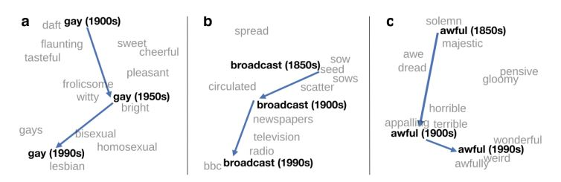
What Analysis Can We Perform?
Hamilton et al. (2016)

Slide 7
Research Questions/Hypothesis
Can/How can we use Natural Language Processing (NLP) to ascertain how the conception of "Terrorism" has evolved through time?
Hypothesis: If Hoffman's assertion is correct, the results of NLP analysis of terrorism-related news texts from the years 1851-1900, 1901-1930, 1931-1950, 1951-1960, and 1961-1980 would be dissimilar.

Slide 8
Why New York Times News Texts?
Consistency
Provide news resources back to 1850s with news under the category of “terrorism”
Convenient to be downloaded in a database

Slide 9
NLP Methods
Data
Retrieval
Pre-processing
Tokenization
Stemming
Vectorization
Train
Test and Validation
Classification

Slide 10
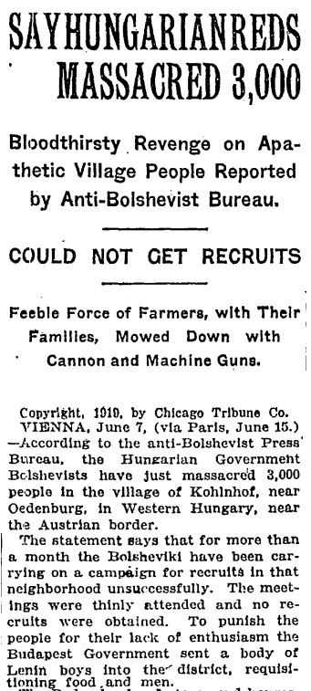
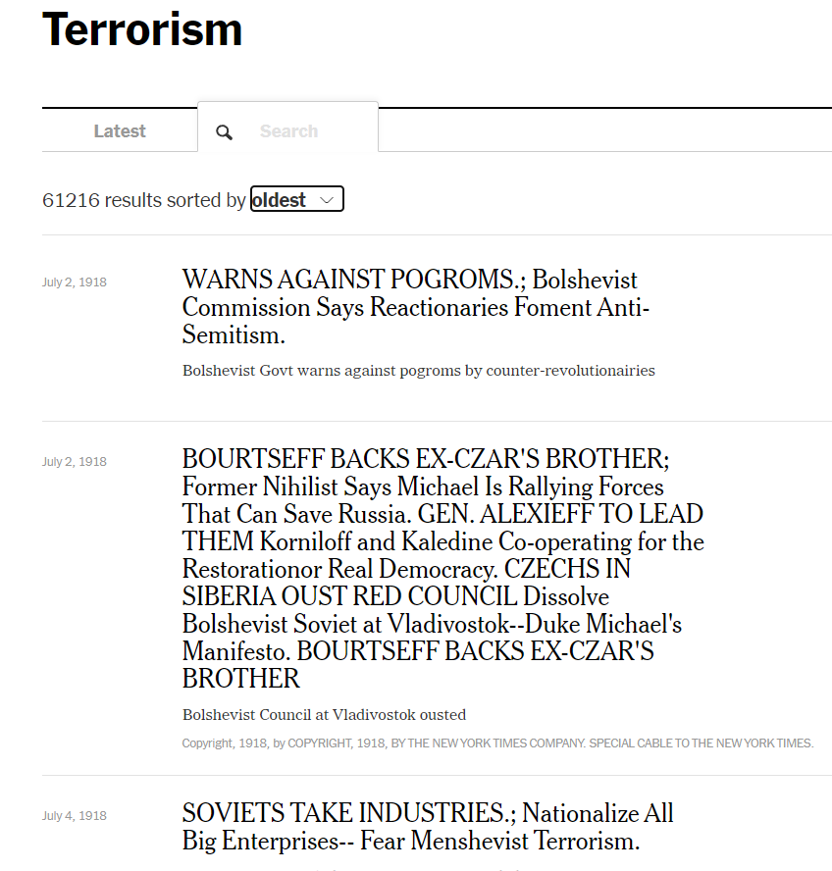
Data: 1850-1980 NYT News in the Terrorism Category

Slide 11
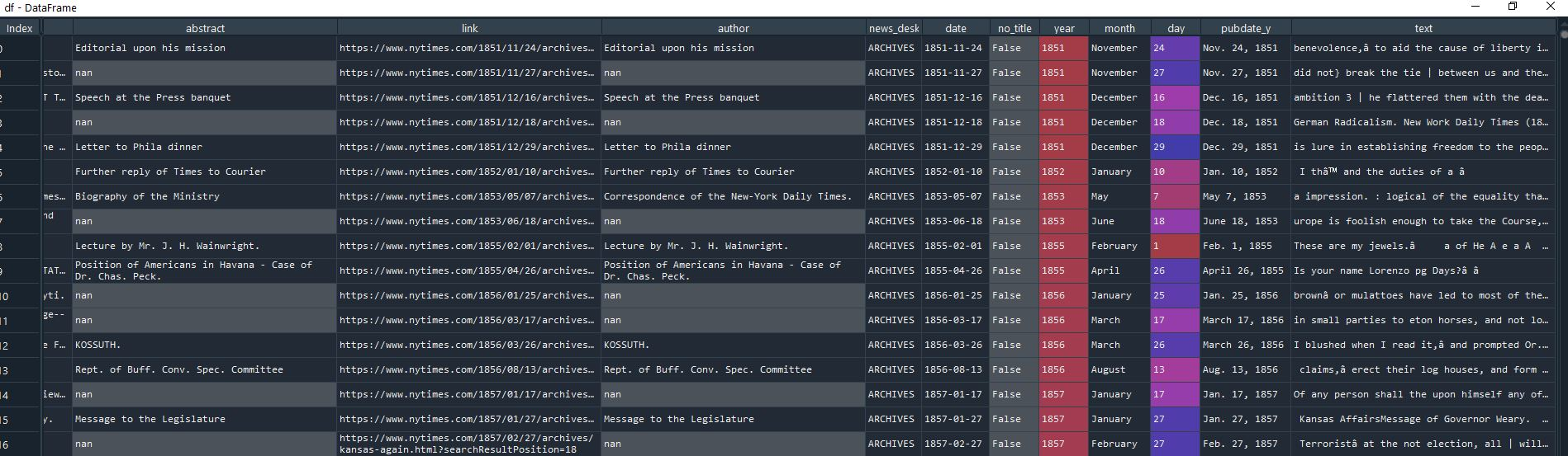
Data

Slide 12
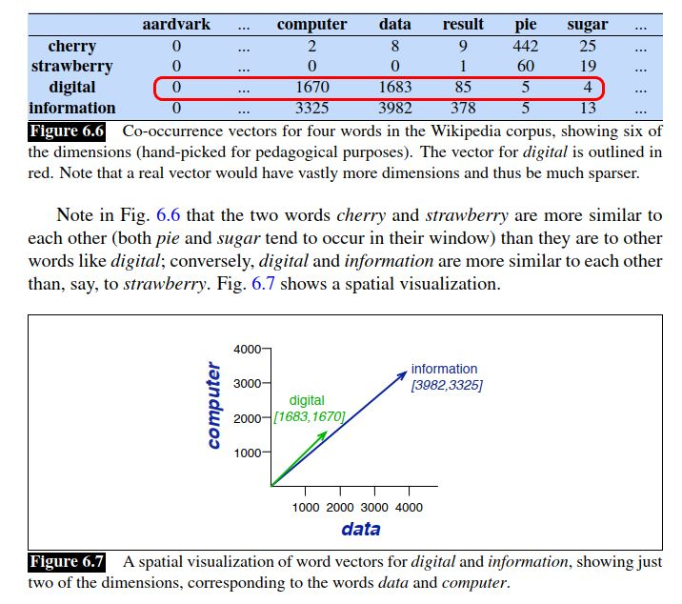
NLP Methods - Vectorization
Methods
Jurafsky & Martin (2021, p.105)

Slide 13
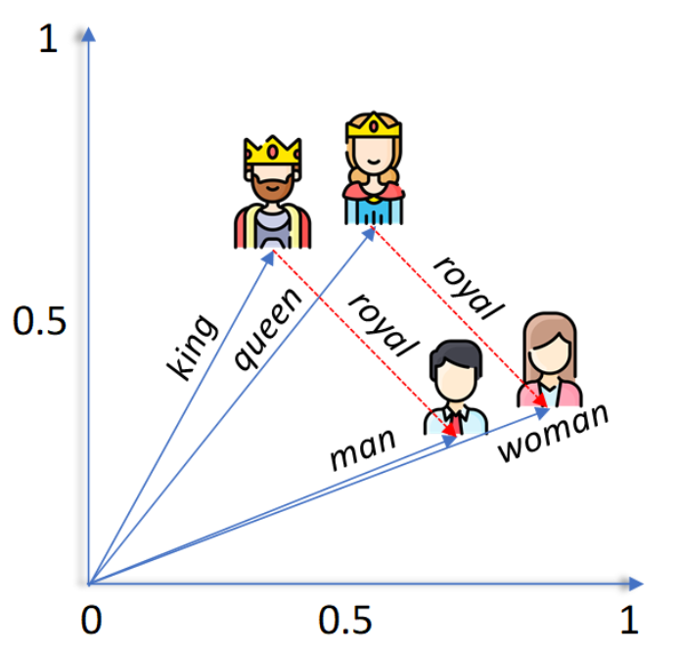
Methods
Word2Vec
Preserves the relationship between words,
and deals with addition of new
words in the vocabulary
Z_ai (2020), Deep Learning for NLP: Word Embeddings. https://towardsdatascience.com/deep-learning-for-nlp-word-embeddings-4f5c90bcdab5

Slide 14
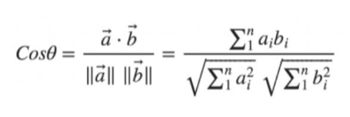
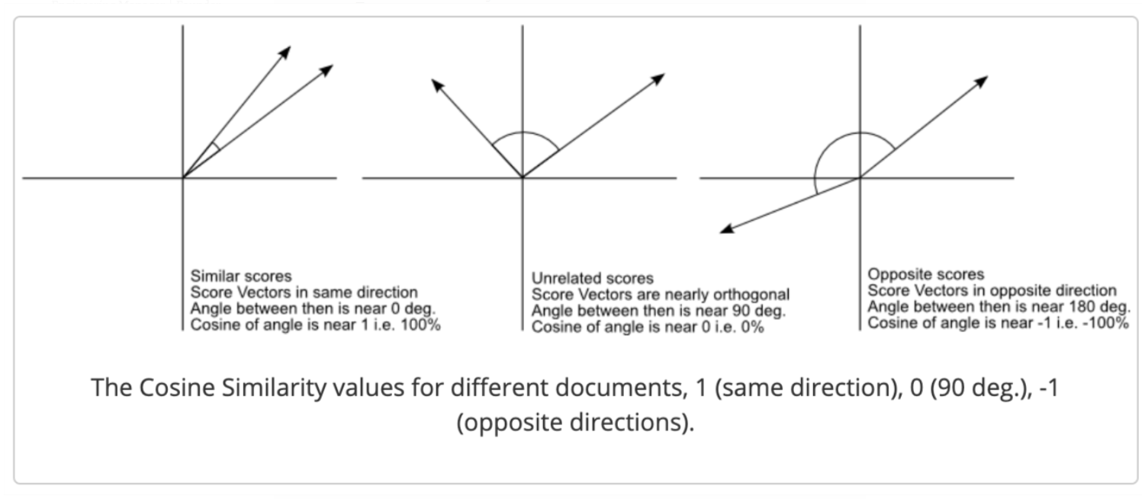
Methods
Cosine Similarity
Christian S. Perone (2013), Machine Learning :: Cosine Similarity for Vector Space Models (Part III). https://blog.christianperone.com/2013/09/machine-learning-cosine-similarity-for-vector-space-models-part-iii/

Slide 15
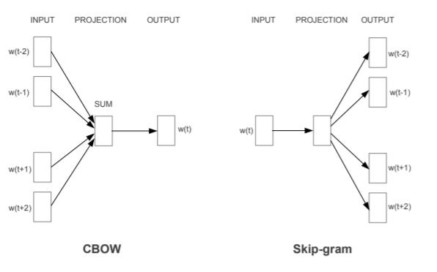
Methods
Embedding Models (Mikolov et al., 2013)
quick
quick
brown
brown
fox
fox
cat
dog
…
cat
dog
…
jump
jump
over
over
Continuous Bag-of-Words Model(CBOW): Predicts the current word based on the context
Skip-gram: Predicts surrounding words given the current word

Slide 16
Descriptive Statistics
Years | Numbers of Articles | Numbers of Tokens
1851-1900 | 885 | 502,212
1901-1930 | 2,126 | 664,334
1931-1950 | 3,665 | 902,281
1951-1960 | 1,885 | 368,161
1961-1980 | 14,104 | 3,917,863

Slide 17
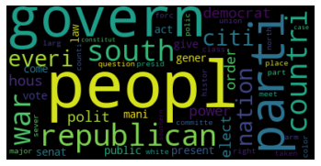
1851-1900
token | raw_frequency | probability(%)
peopl | 2508 | 0.577085
govern | 2314 | 0.532446
parti | 1740 | 0.40037
republican | 1547 | 0.355961
south | 1445 | 0.332491
countri | 1422 | 0.327199
war | 1408 | 0.323978
everi | 1303 | 0.299817
nation | 1288 | 0.296366
citi | 1265 | 0.291074
democrat | 1211 | 0.278648
hous | 1197 | 0.275427
power | 1197 | 0.275427
polit | 1189 | 0.273586
order | 1181 | 0.271745
elect | 1169 | 0.268984
public | 1137 | 0.261621
vote | 1121 | 0.25794
senat | 1101 | 0.253338
gener | 1099 | 0.252877
present | 1092 | 0.251267
act | 1073 | 0.246895
give | 1046 | 0.240682
mani | 1027 | 0.23631
come | 1011 | 0.232629

Slide 18
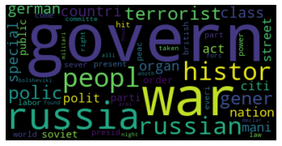
1901-1930
token | raw_frequency | probability(%)
govern | 4731 | 0.818882
war | 2943 | 0.5094
russia | 2793 | 0.483436
peopl | 2388 | 0.413335
histor | 2206 | 0.381833
russian | 2158 | 0.373525
polic | 2119 | 0.366775
gener | 2096 | 0.362794
terrorist | 2060 | 0.356562
german | 1984 | 0.343408
class | 1919 | 0.332157
countri | 1785 | 0.308963
special | 1750 | 0.302905
organ | 1640 | 0.283865
nation | 1623 | 0.280923
street | 1621 | 0.280577
mani | 1616 | 0.279711
polit | 1609 | 0.278499
citi | 1603 | 0.277461
act | 1518 | 0.262748
parti | 1506 | 0.260671
order | 1452 | 0.251325
soviet | 1428 | 0.24717
public | 1380 | 0.238862
present | 1356 | 0.234708

Slide 19
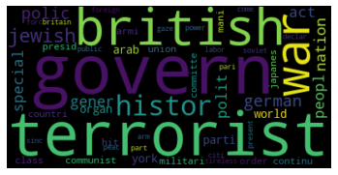
1931-1950
token | raw_frequency | probability(%)
govern | 6398 | 0.818667
terrorist | 5694 | 0.728586
british | 4525 | 0.579004
war | 4153 | 0.531404
histor | 3816 | 0.488283
jewish | 3490 | 0.446569
german | 3342 | 0.427631
polic | 3219 | 0.411893
nation | 3026 | 0.387197
gener | 2789 | 0.356871
polit | 2765 | 0.3538
act | 2648 | 0.33883
special | 2644 | 0.338318
peopl | 2556 | 0.327057
organ | 2438 | 0.311959
arab | 2436 | 0.311703
world | 2422 | 0.309911
parti | 2292 | 0.293277
york | 2234 | 0.285855
presid | 2184 | 0.279458
countri | 2157 | 0.276003
communist | 2116 | 0.270757
japanes | 2103 | 0.269093
class | 2091 | 0.267558
militari | 1938 | 0.24798

Slide 20
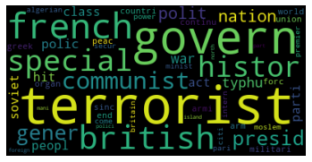
1951-1960
token | raw_frequency | probability(%)
terrorist | 3376 | 1.060761
govern | 2632 | 0.826992
french | 2343 | 0.736186
british | 2066 | 0.649151
special | 2000 | 0.628413
histor | 1917 | 0.602334
communist | 1840 | 0.57814
gener | 1430 | 0.449315
presid | 1368 | 0.429835
polit | 1358 | 0.426692
nation | 1342 | 0.421665
typhu | 1331 | 0.418209
war | 1294 | 0.406583
polic | 1200 | 0.377048
peopl | 1034 | 0.32489
class | 1032 | 0.324261
act | 990 | 0.311064
parti | 975 | 0.306351
soviet | 970 | 0.30478
hit | 966 | 0.303524
militari | 955 | 0.300067
armi | 932 | 0.29284
world | 898 | 0.282157
organ | 847 | 0.266133
union | 847 | 0.266133

Slide 21
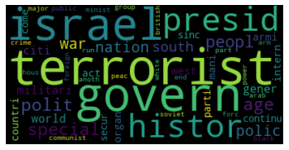
1961-1980
token | raw_frequency | probability(%)
terrorist | 22699 | 0.67199
govern | 20489 | 0.606565
israel | 18132 | 0.536787
presid | 15188 | 0.449632
histor | 14855 | 0.439773
special | 13978 | 0.41381
polit | 13763 | 0.407445
age | 13227 | 0.391577
peopl | 12889 | 0.381571
polic | 12472 | 0.369226
nation | 11955 | 0.353921
war | 11691 | 0.346105
south | 10166 | 0.300958
militari | 10051 | 0.297554
world | 9404 | 0.2784
citi | 9314 | 0.275735
gener | 9189 | 0.272035
act | 8564 | 0.253532
armi | 8142 | 0.241039
organ | 8045 | 0.238167
countri | 7909 | 0.234141
west | 7767 | 0.229937
mani | 7538 | 0.223158
come | 7510 | 0.222329
intern | 7461 | 0.220878

Slide 22
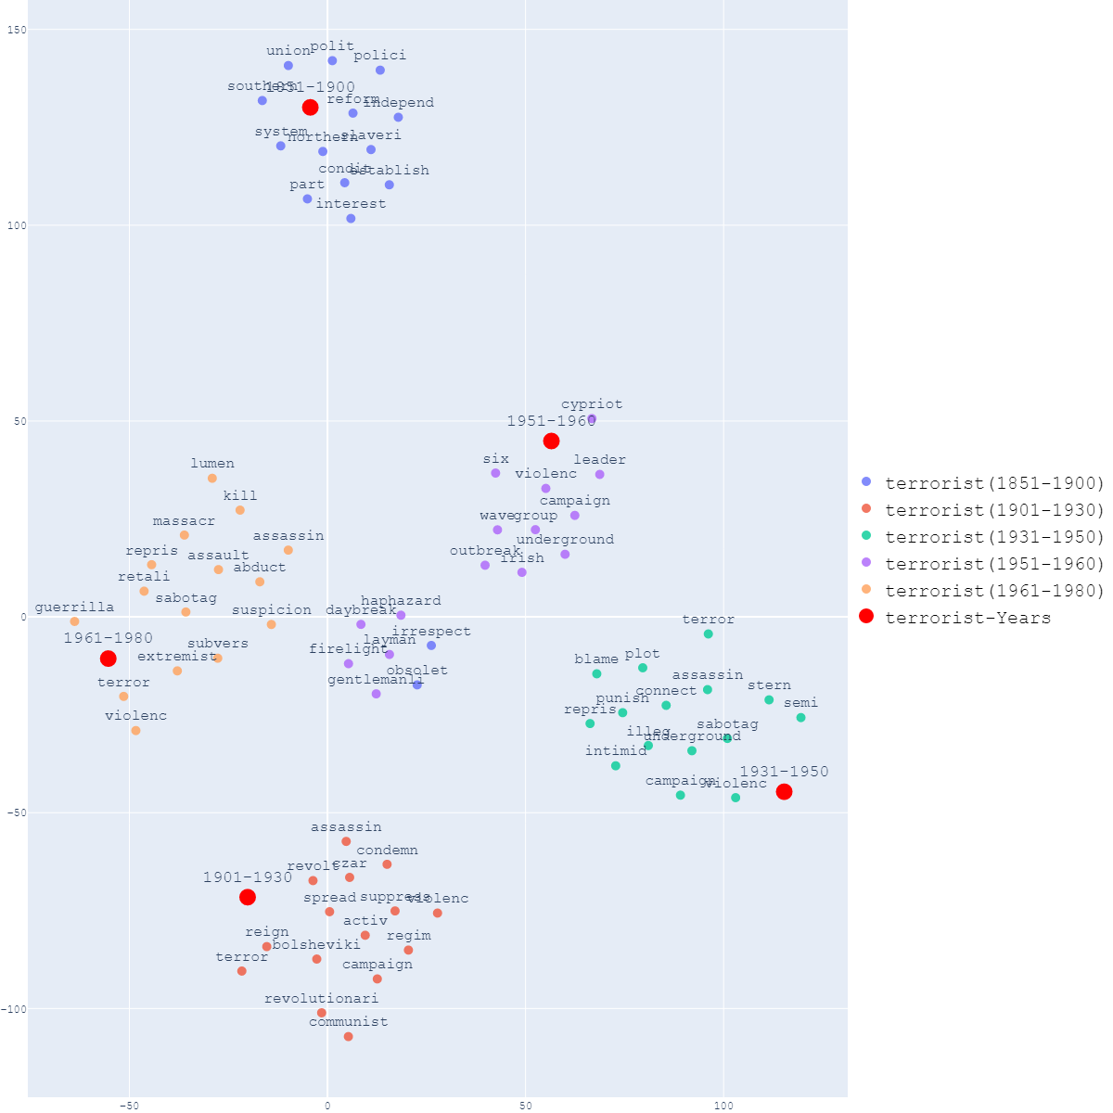
Similar Words

Slide 23
Conclusion
Provided evidence supporting Hoffman’s (2006) claim– the transformation of the concept of terrorism
The concept of terrorism evolves over time.

Slide 24
Limitation
Bias in the algorithm
When it comes to earlier eras, news articles are far more scarce than they were in the 1960s and 1980s.
Some words lose their meaning when they are stemmed.
Some news are under the wrong categories of NYT news articles.

Slide 25
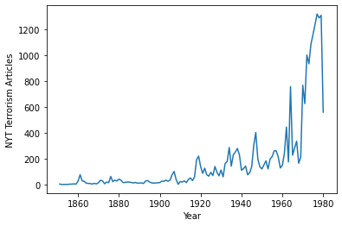
Limitation

Slide 26
Using the Pre-Trained Data from Google News
Top 15 Similar Words of “terrorist”
terror
terrorists
terrorism
al_Qaeda
Terrorist
Al_Qaeda
extremist
al_Qa'ida
jihadist
al_Qaida
militant
jihadi
Islamic_extremist
al_Qa'eda
Al_Qa'ida
Data resource:
Google Code Archive. (2013). Word2Vec. https://code.google.com/archive/p/word2vec/

Slide 27
言者所以在意，得意而忘言《莊子·外物》
Words are for meaning; Once you get the meaning, you can forget the words. (Zhuang Zi)

Slide 28
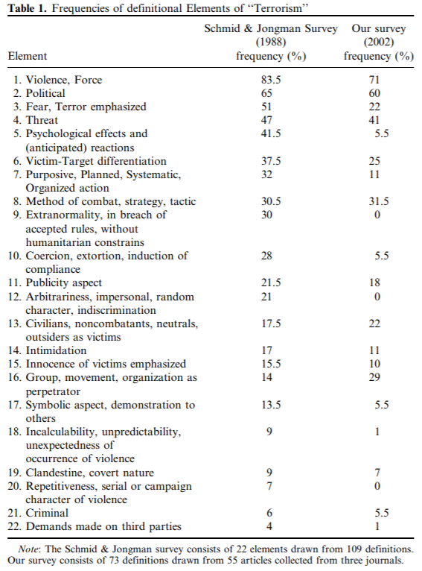
Appendix -- 22 elements of the definition of terrorism
Resource:
Weinberg et al. (2004)

Slide 29
References
Bruce Hoffman. (2006). Inside Terrorism, Revised and Expanded Edition. Columbia University Press.
Schmid, A. P., Jongman, A. J., & Stohl, M. (1988). Political terrorism : a new guide to actors, authors, concepts, data bases, theories, and literature (Rev., expanded and updated ed.). North-Holland Pub. Co.
Weinberg, L., Pedahzur, A., & Hirsch-Hoefler, S. (2004). The challenges of conceptualizing terrorism. Terrorism and Policical Violence, 16(4), 777-794.
Mitnik, Z. S., Freilich, J. D., & Chermak, S. M. (2018). Post-9/11 Coverage of Terrorism in the New York Times. Justice Quarterly, 1–25.
Jetter, M. (2019). More Bang for the Buck: Media Coverage of Suicide Attacks. Terrorism and Political Violence, 31(4), 779–799.
Nellis, A. M., & Savage, J. (2012). Does Watching the News Affect Fear of Terrorism? The Importance of Media Exposure on Terrorism Fear. Crime & Delinquency, 58(5), 748–768.
Chermak, S. M., & Gruenewald, J. (2006). The Media’s Coverage of Domestic Terrorism. Justice Quarterly, 23(4), 428–461.
Hamilton, W. L., Leskovec, J., & Jurafsky, D. (2016). Diachronic word embeddings reveal statistical laws of semantic change. arXiv preprint arXiv:1605.09096.
Google Code Archive. (2013). Word2Vec. Retrieved from https://code.google.com/archive/p/word2vec/
Mikolov, T., Chen, K.,Corrado, G., & Dean, J. (2013). Efficient estimation of word representations in vector space. arXiv preprint arXiv:1301.3781.

